Slide 1

Background and Cursor
By: Dalia Ihab

Slide 2


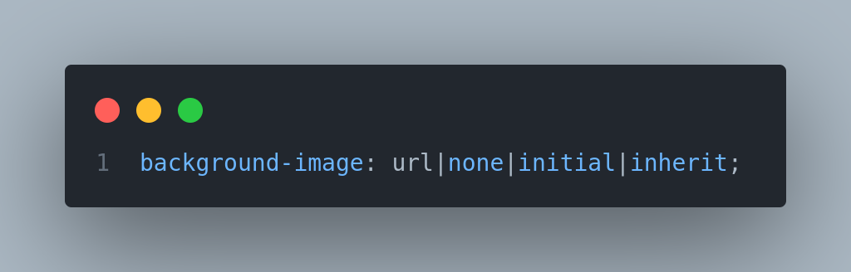
Background Image
The background-image property sets one or more background images for an element.

Slide 3
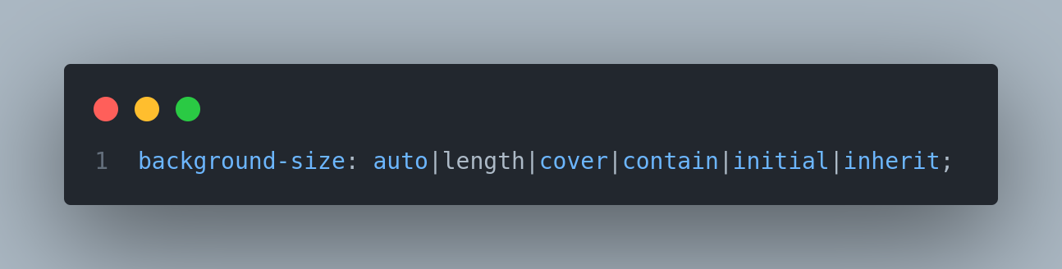
Background Size
The background-size property specifies the size of the background images.

Slide 4
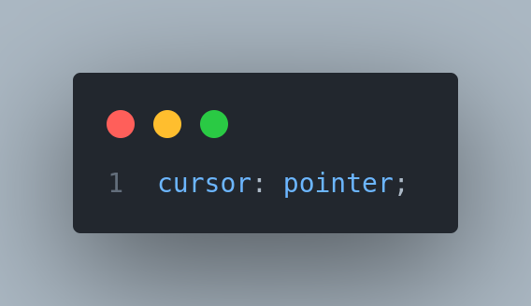
Cursor
The cursor property specifies the mouse cursor to be displayed when pointing over an element.

Slide 5


Next
Box Model

